Slide 1


By – Aditya Shivaji Warungase

Slide 2


About Me
ADITYA Shivaji Warungase
Bachelor of Engineering in Artificial Intelligence and Data Science
I am passionate about Data Science, as I enjoy working with data, uncovering insights, and transforming information into meaningful solutions.
I love exploring new technologies, solving real-world problems, and continuously improving my technical skills
My goal is to make data tell impactful stories that drive smart decisions.
Linkedln | GitHub

Slide 3
Index
Index
1. | Business Objective
2. | Web Scrapping Details
3. | Data Cleaning Steps
4. | Initial Dataset
5. | Clean Dataset
6. | Analysis
7. | Conclusion

Slide 4
Business Objective
The primary objective of this project is to extract Fortune 500 company data from reliable web sources using Selenium and Beautiful Soup. The scraped data is cleaned, structured, and stored in an csv file for analysis. Exploratory Data Analysis (EDA) is conducted to uncover trends in company rankings, revenue, profit and employee distribution. The project aims to identify top-performing companies. The insights derived support strategic business analysis and informed decision-making.

Slide 5
Web Scraping-Details
Data was scraped from the official Fortune website, which published 2025 Fortune 500 company ranking.
Selenium was used to automate browser interactions and handle dynamic, JavaScript-loaded web pages.
Page load delays and dynamic elements were managed using explicit waits in Selenium.
Beautiful Soup was used to parse the HTML content and extract required information such as company rank, name, revenue, profit, and year.
The final cleaned and structured data was saved into an CSV file for further Exploratory Data Analysis (EDA).

Slide 6
Data Cleaning Steps
Handled missing and null values by either removing rows.
Standardized column names for consistency and readability.
Converted revenue, profit, and other numeric fields from text to proper numerical data types.
Removed special characters such as commas, dollar signs, and symbols from numeric columns.
Checked and corrected incorrect data entries caused by scraping errors.
Exported the cleaned dataset into an CSV file for Exploratory Data Analysis (EDA).

Slide 7
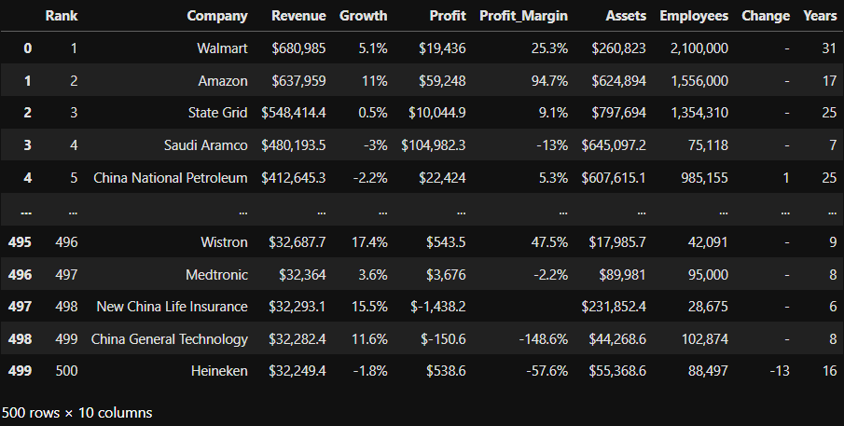
Initial Scraped Dataset

Slide 8
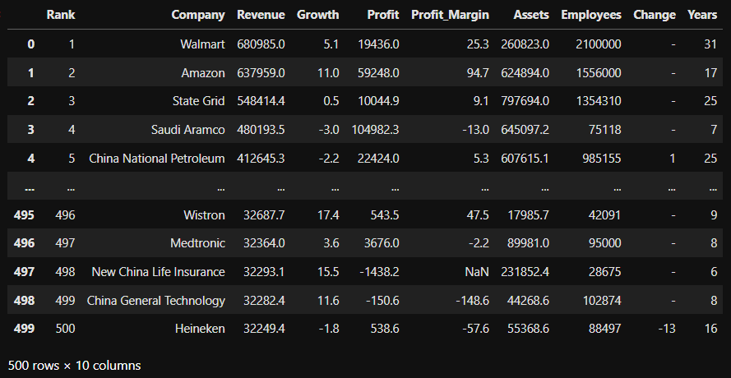
Clean Data

Slide 9
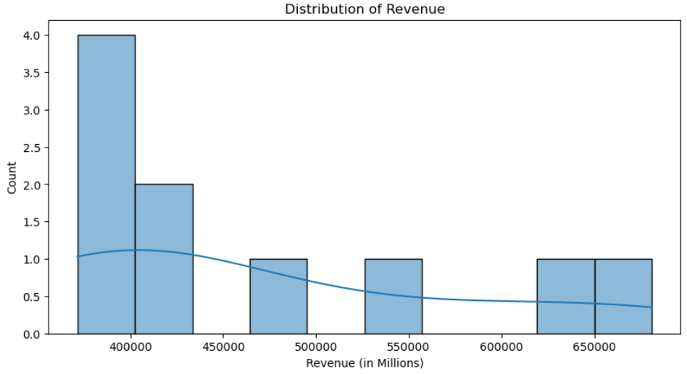
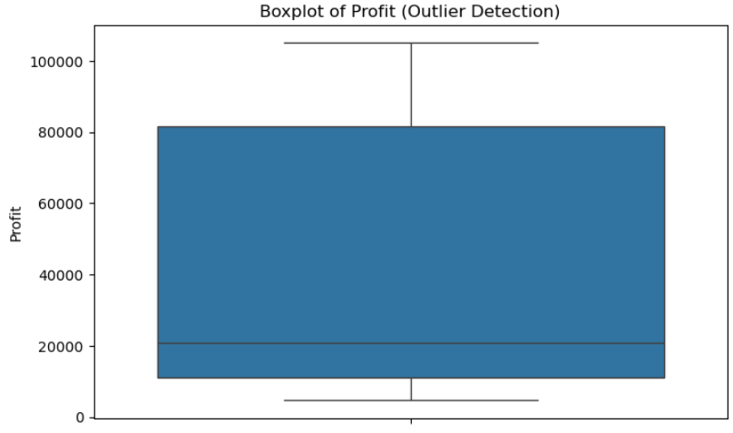
Univariate Analysis
Revenue Distribution:
Most companies have revenues concentrated between 380,000 and 450,000 million. A smaller number of companies generate significantly higher revenues, ranging from 550,000 to 680,000 million, creating a right-skewed distribution. This indicates that only a few Fortune 500 companies dominate the highest revenue bracket.
Profit Boxplot:
The median profit is around 20,000 million, showing that half of the companies earn profits below this value. The lower profit range starts near 5,000 million, while the upper range extends beyond 80,000 million. An extreme outlier close to 100,000 million profit represents highly profitable companies such as Saudi Aramco.

Slide 10
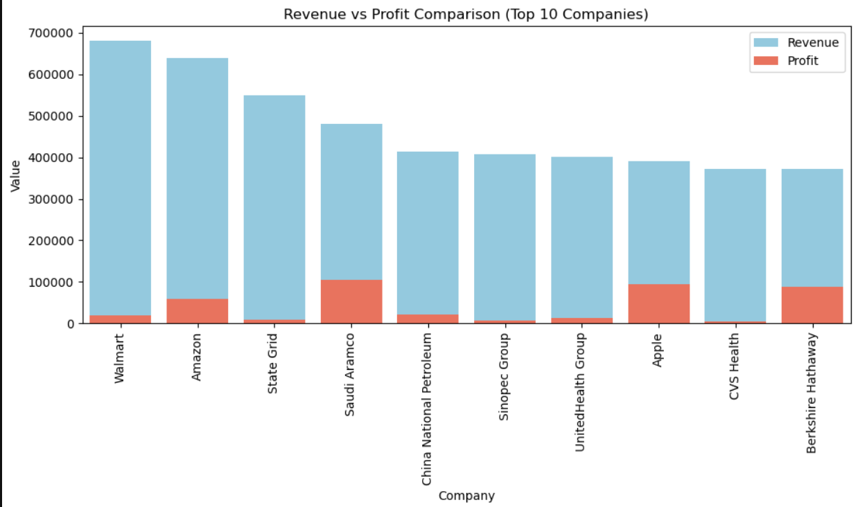
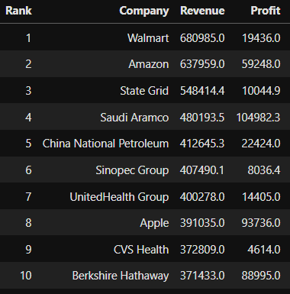
Bivariate Analysis
High revenue does NOT always mean high profit
In the Fortune 500 list, many companies have:
Very high revenue, But low profit
Because of thin profit margins
Example:
Some companies generate huge revenue but their profitability is low, indicating high operational costs or low margins.
Revenue vs Profit

Slide 11
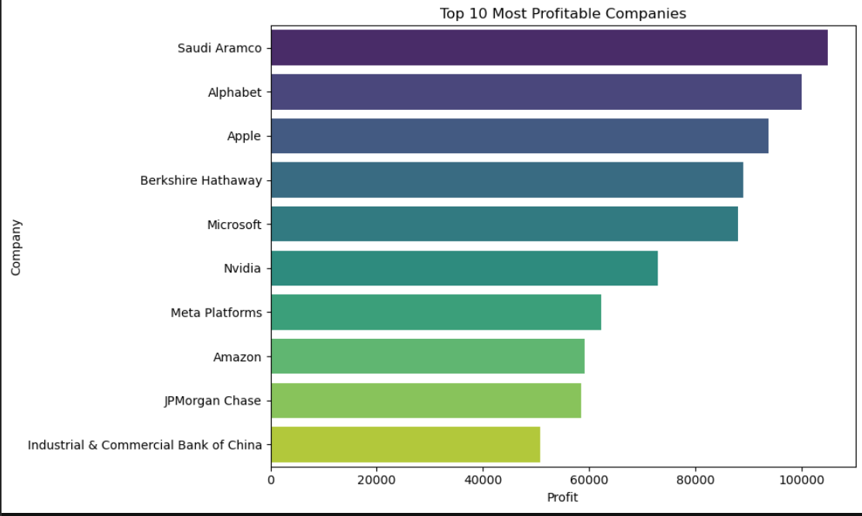
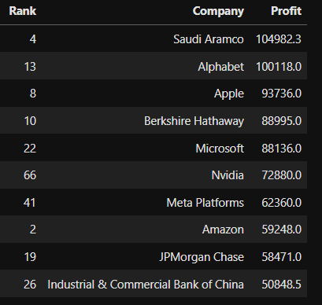
Rank does not perfectly reflect Profit
Rank is based mainly on revenue.
Profit ranking can be very different.
Insight:
A company may rank high by revenue but still have relatively low profit, meaning rank alone does not indicate financial strength.
Company vs Profit

Slide 12
Challenges and Experience
Faced challenges in scraping dynamic web data using Selenium due to JavaScript-loaded content.
Handled messy and inconsistent data, including missing values and incorrect formats.
Learned how to clean and preprocess real-world data for accurate analysis.
Gained experience in Exploratory Data Analysis (EDA) to identify trends and outliers.
Understood that business insights matter more than just graphs, such as revenue not always indicating profit.

Slide 13
Conclusion
This project successfully scraped Fortune 500 data for the last five years using Selenium and Beautiful Soup. After cleaning and manipulating the data, Exploratory Data Analysis identified important trends in company rankings, revenue growth performance. The analysis highlighted top-performing company. Overall, the project demonstrates how web scraping and data analysis can generate meaningful business insights to support strategic decision-making.

